Slide 1

NETFLIX MOVIES DATA ANALYSIS IN SQL
MANISHA MALPANI

Slide 2

Netflix movie data analysis in SQL involves using SQL queries to explore and analyze data related to movies available on the Netflix platform. The process includes the following steps:
Data Retrieval: Fetch Netflix movie data from the database.
Filtering: Apply criteria to narrow down the dataset (e.g., by genre, release year).
Sorting: Organize data to identify trends (e.g., most-watched, top-rated).
Aggregation: Use functions to calculate metrics (e.g., total viewership, average rating).
Pattern Analysis: Identify viewing behavior patterns across demographics, times, regions.
Performance Evaluation: Assess newly added movies based on viewership and ratings.
Data-Driven Decisions: Provide insights for improving recommendations, content acquisition, and user satisfaction.
By leveraging SQL, analysts can efficiently process and interpret large volumes of data, helping Netflix refine its offerings and user experience.

Slide 3

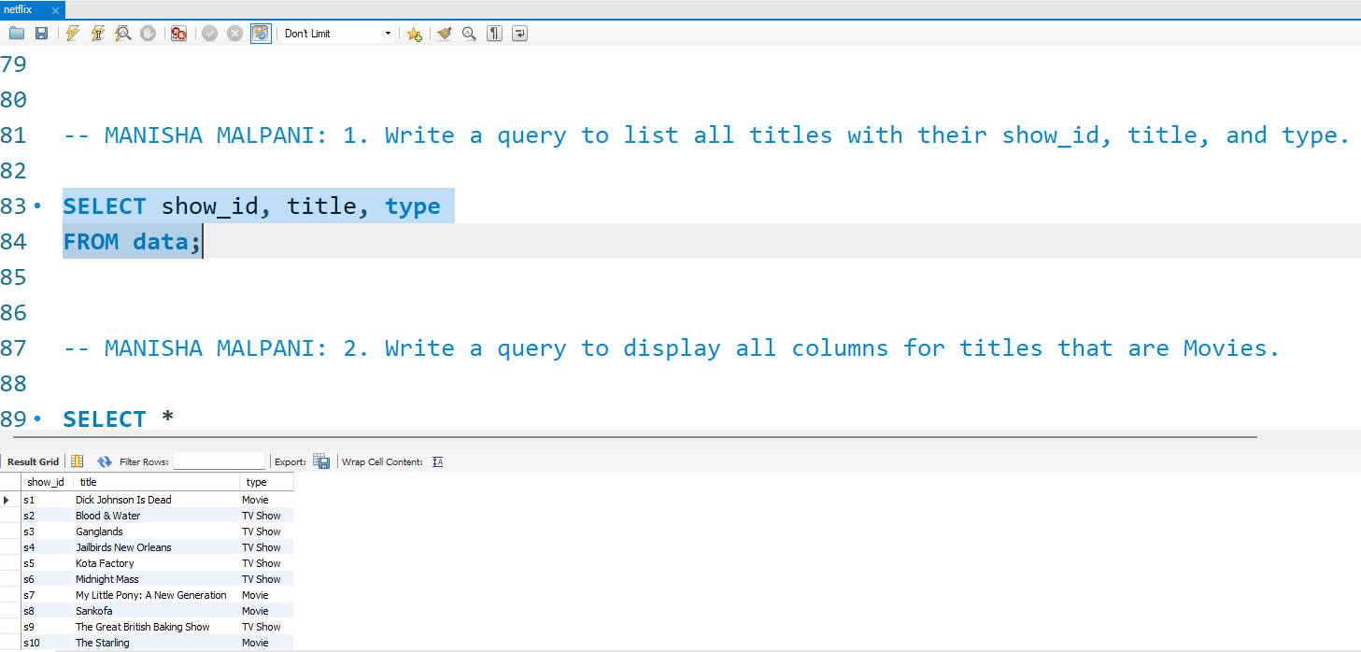
Write a query to list all titles with their show_id, title, and type.
Query –
SELECT show_id, title, type FROM data;

Slide 4
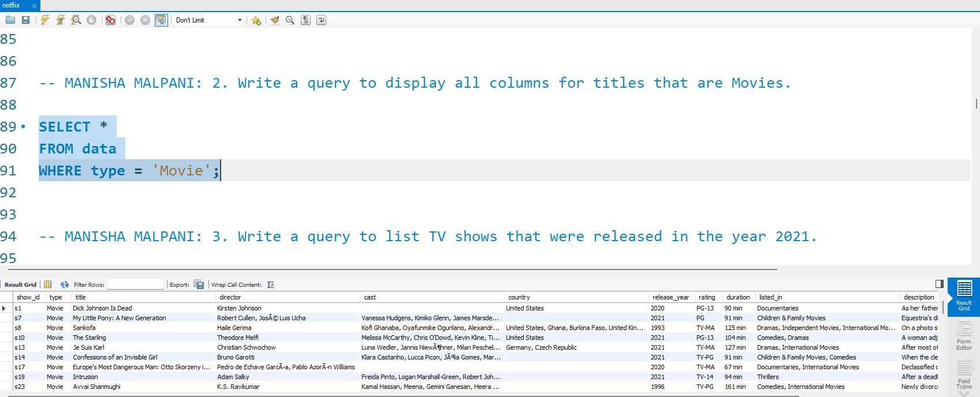
2. Write a query to display all columns for titles that are Movies.
Query –
SELECT * FROM data WHERE type = 'Movie';

Slide 5
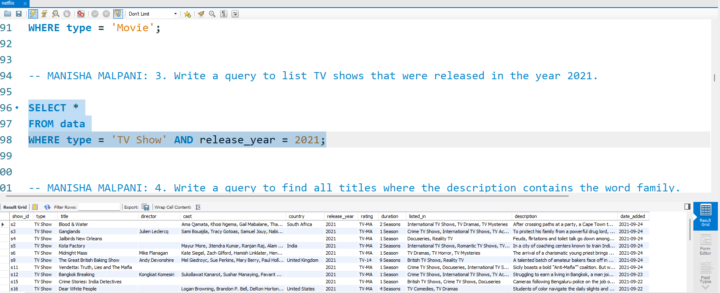
3. Write a query to list TV shows that were released in the year 2021.
Query –
SELECT * FROM data WHERE type = 'TV Show' AND release_year = 2021;

Slide 6
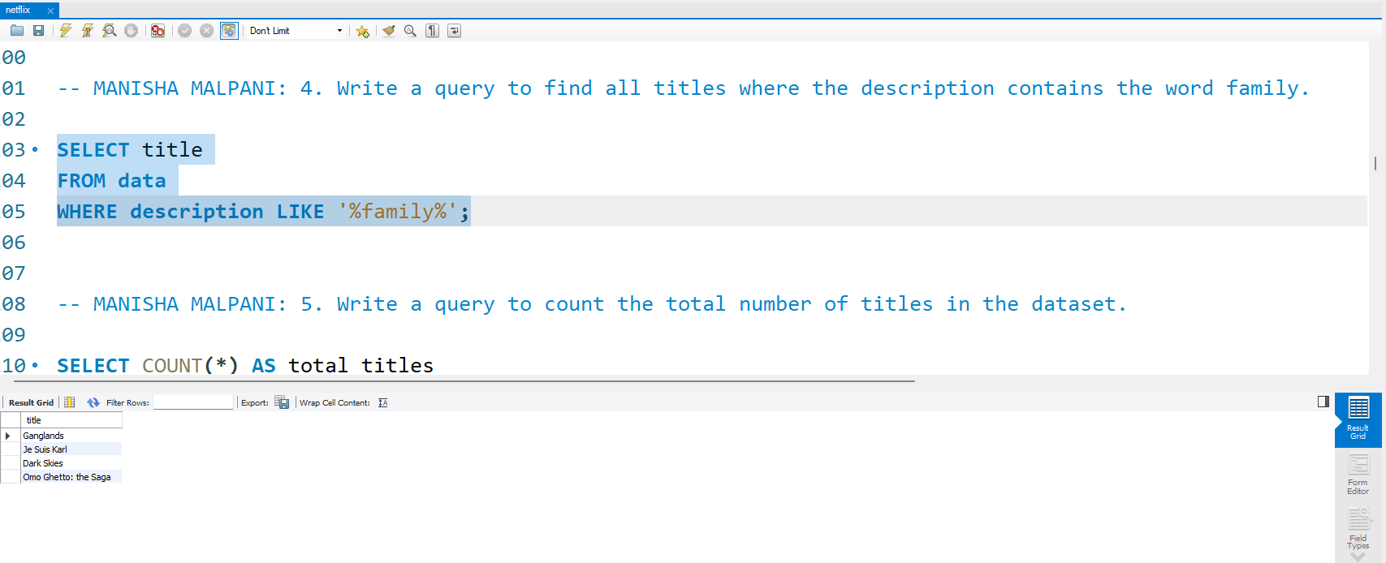
4. Write a query to find all titles where the description contains the word family.
Query –
SELECT title FROM data WHERE description LIKE '%family%';

Slide 7
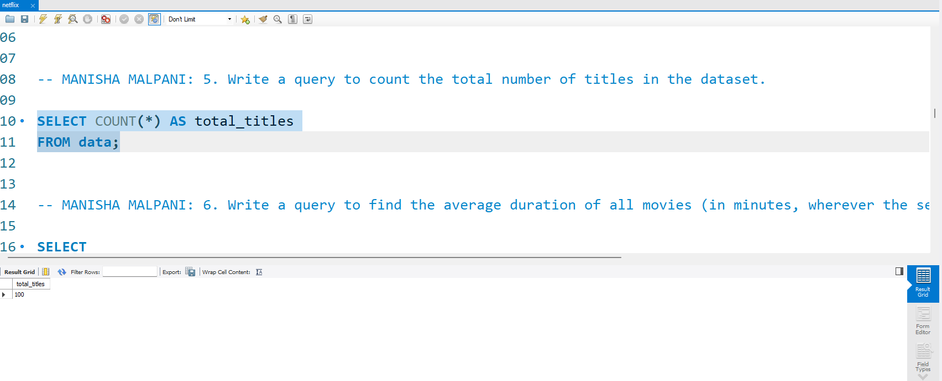
5. Write a query to count the total number of titles in the dataset.
Query –
SELECT COUNT(*) AS total_titles FROM data;

Slide 8
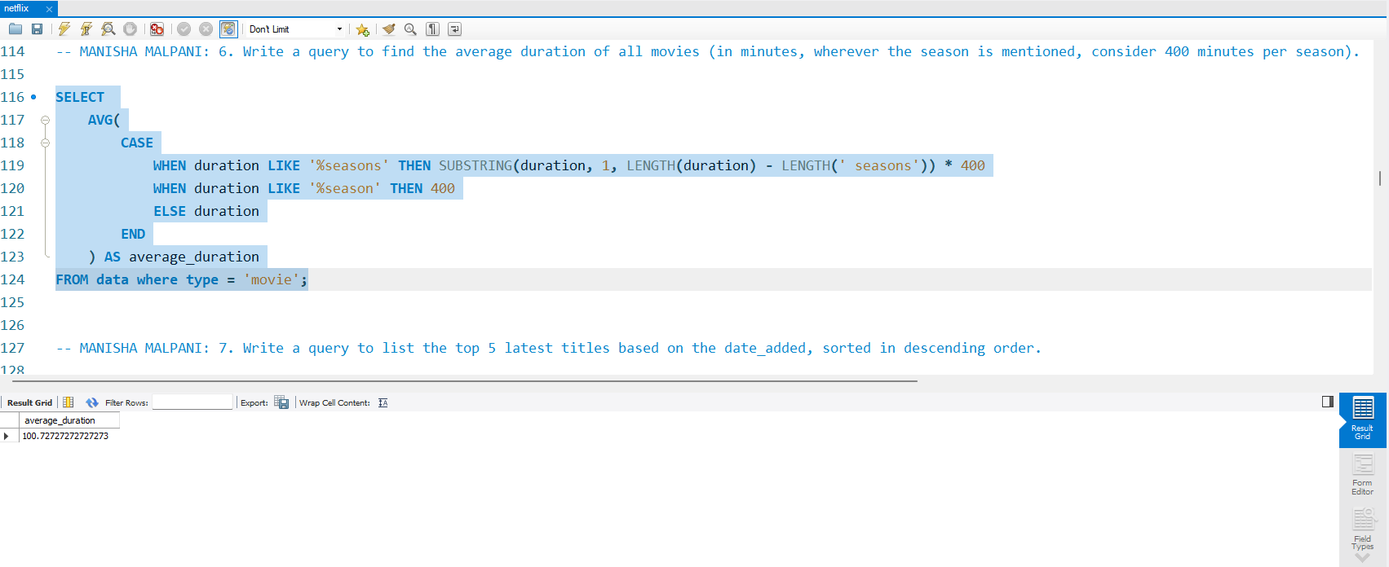
6. Write a query to find the average duration of all movies (in minutes, wherever the season is mentioned, consider 400 minutes per season).
Query –
SELECT AVG(CASE WHEN duration LIKE '%seasons' THEN SUBSTRING(duration, 1, LENGTH(duration) - LENGTH(' seasons')) * 400 WHEN duration LIKE '%season' THEN 400 ELSE duration END) AS average_duration FROM data where type = 'movie';

Slide 9
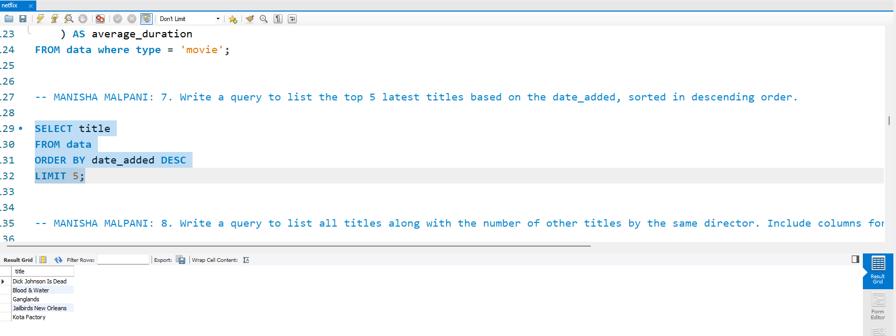
7. Write a query to list the top 5 latest titles based on the date_added, sorted in descending order.
Query –
SELECT title FROM data ORDER BY date_added DESC LIMIT 5;

Slide 10
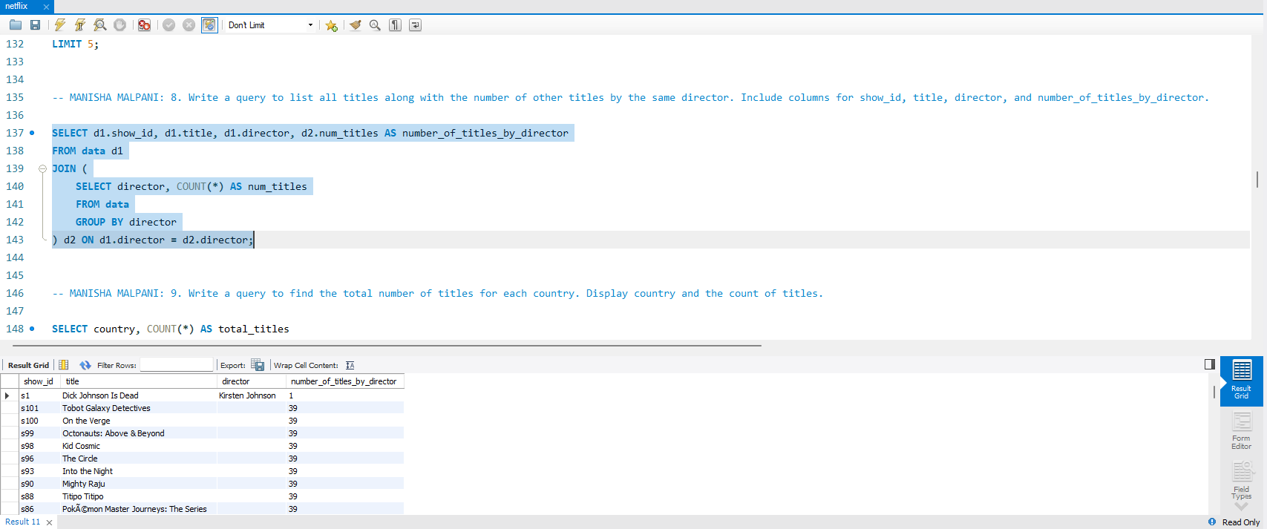
8. Write a query to list all titles along with the number of other titles by the same director. Include columns for show_id, title, director, and number_of_titles_by_director.
Query –
SELECT d1.show_id, d1.title, d1.director, d2.num_titles AS number_of_titles_by_director FROM data d1 JOIN (SELECT director, COUNT(*) AS num_titles FROM data GROUP BY director) d2 ON d1.director = d2.director;

Slide 11
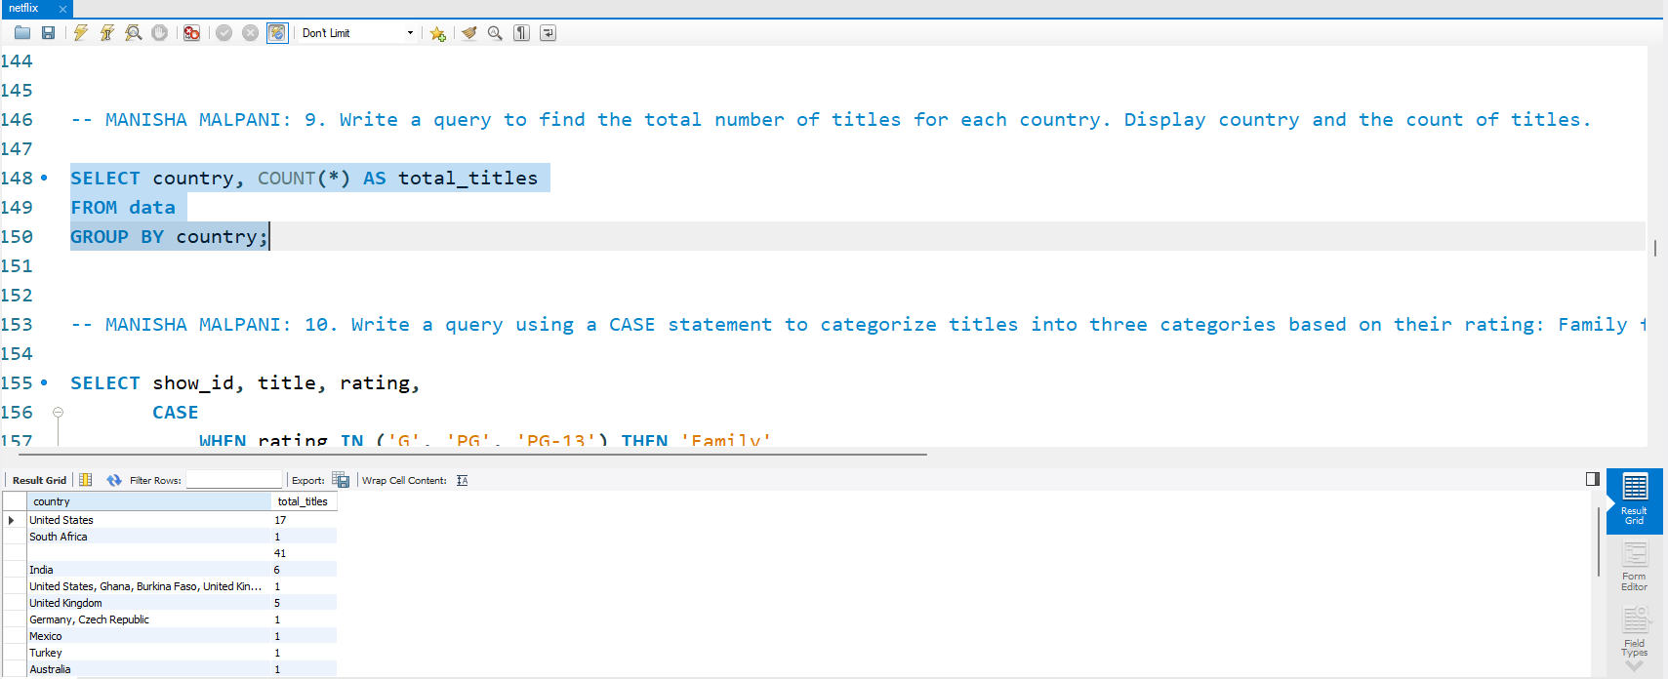
9. Write a query to find the total number of titles for each country. Display country and the count of titles.
Query –
SELECT country, COUNT(*) AS total_titles FROM data GROUP BY country;

Slide 12
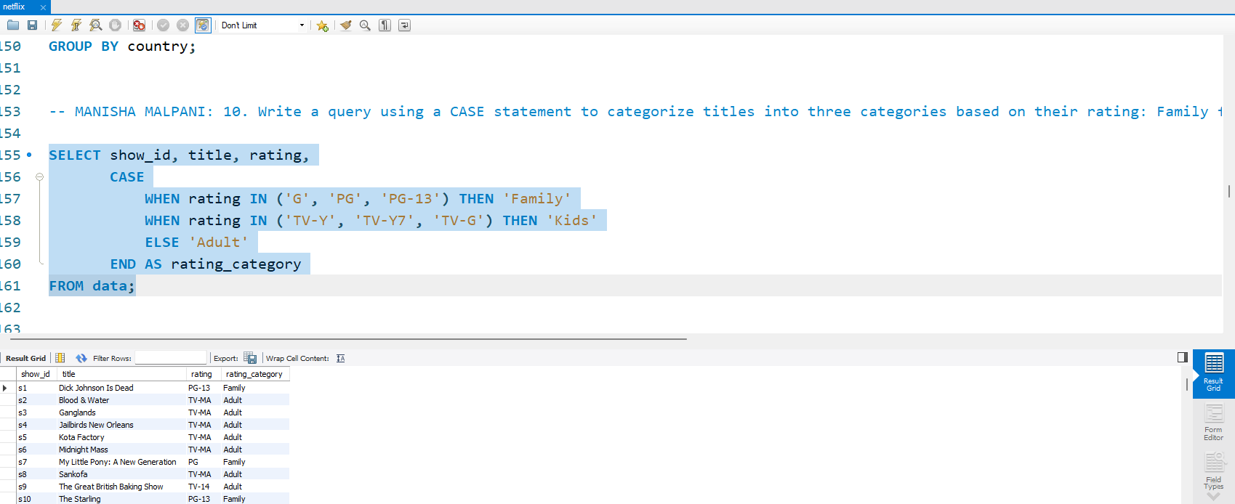
10. Write a query using a CASE statement to categorize titles into three categories based on their rating: Family for ratings G, PG, PG-13, Kids for TV-Y, TV-Y7, TV-G, and Adult for all other ratings.
Query –
SELECT show_id, title, rating, CASE WHEN rating IN ('G', 'PG', 'PG-13') THEN 'Family’ WHEN rating IN ('TV-Y', 'TV-Y7', 'TV-G') THEN 'Kids’ ELSE 'Adult’ END AS rating_category FROM data;

Slide 13
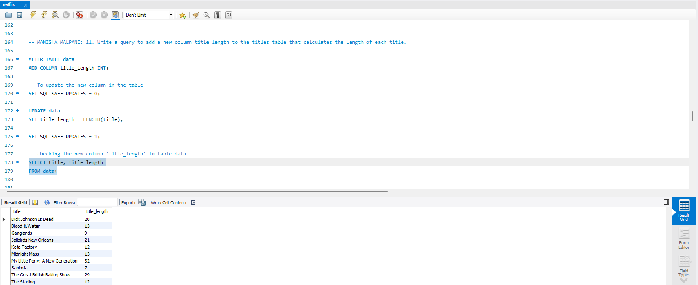
11. Write a query to add a new column title_length to the titles table that calculates the length of each title.
Query –
ALTER TABLE data ADD COLUMN title_length INT;
UPDATE data SET title_length = LENGTH(title);
SELECT title, title_length FROM data;

Slide 14
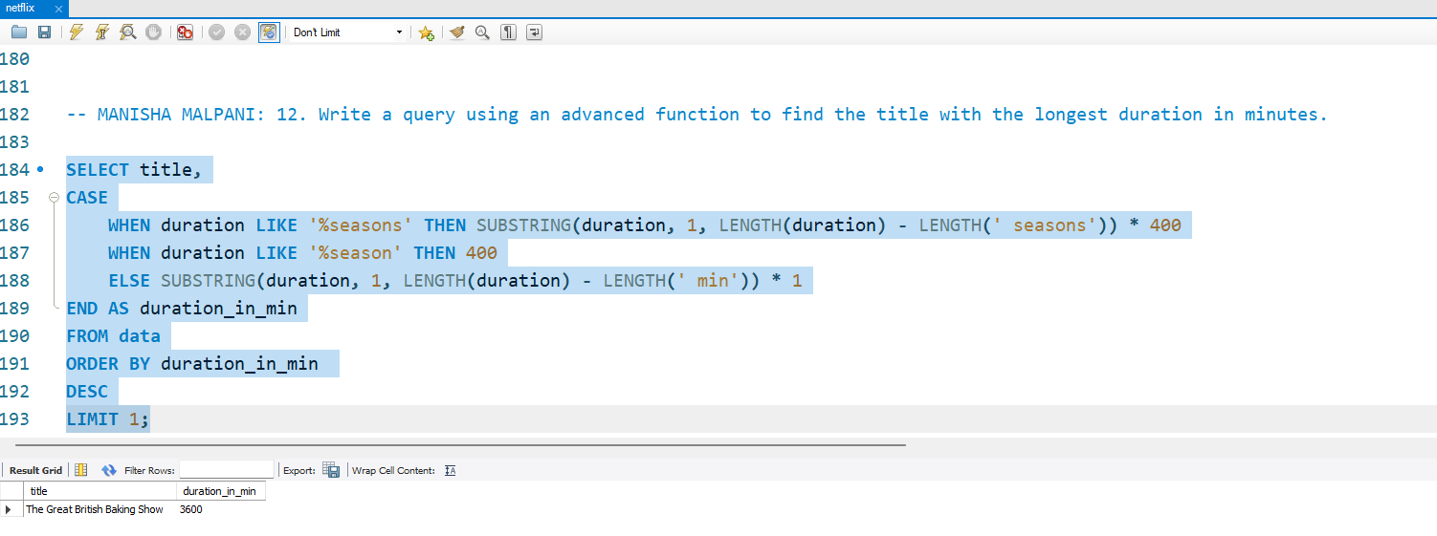
12. Write a query using an advanced function to find the title with the longest duration in minutes.
Query –
SELECT title,CASE WHEN duration LIKE '%seasons' THEN SUBSTRING(duration, 1, LENGTH(duration) - LENGTH(' seasons')) * 400 WHEN duration LIKE '%season' THEN 400 ELSE SUBSTRING(duration, 1, LENGTH(duration) - LENGTH(' min')) * 1 END AS duration_in_min FROM data ORDER BY duration_in_min DESC LIMIT 1;

Slide 15
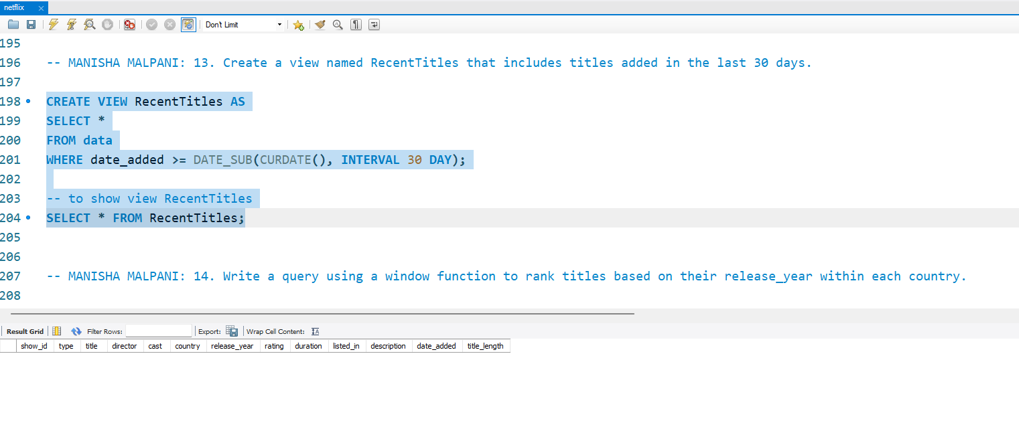
13. Create a view named RecentTitles that includes titles added in the last 30 days.
Query –
CREATE VIEW RecentTitles AS SELECT * FROM data WHERE date_added >= DATE_SUB(CURDATE(), INTERVAL 30 DAY);

Slide 16
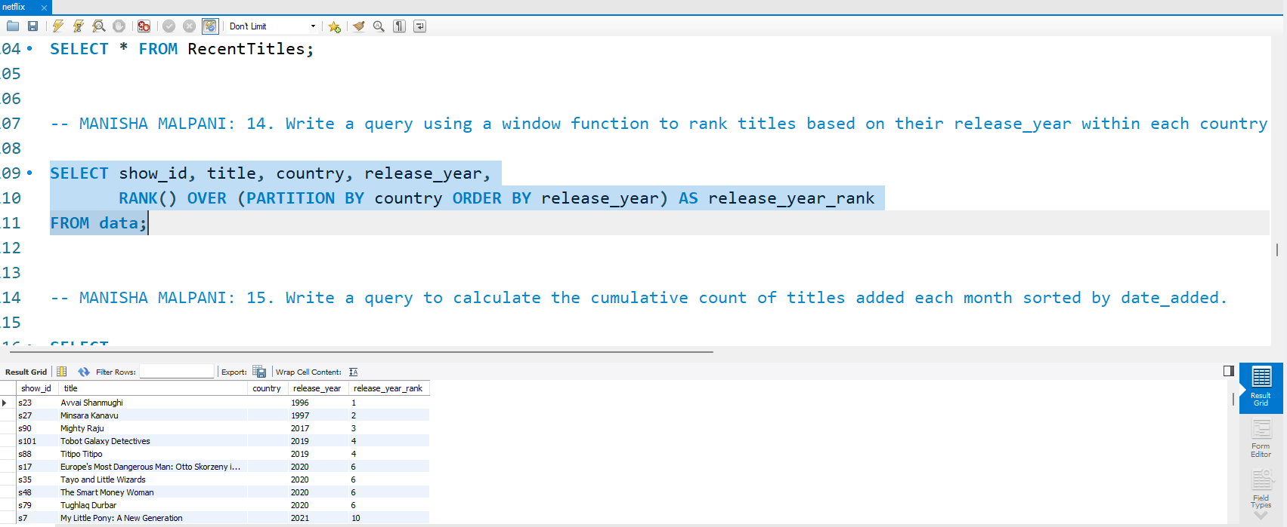
14. Write a query using a window function to rank titles based on their release_year within each country.
Query –
SELECT show_id, title, country, release_year, RANK() OVER (PARTITION BY country ORDER BY release_year) AS release_year_rank FROM data;

Slide 17
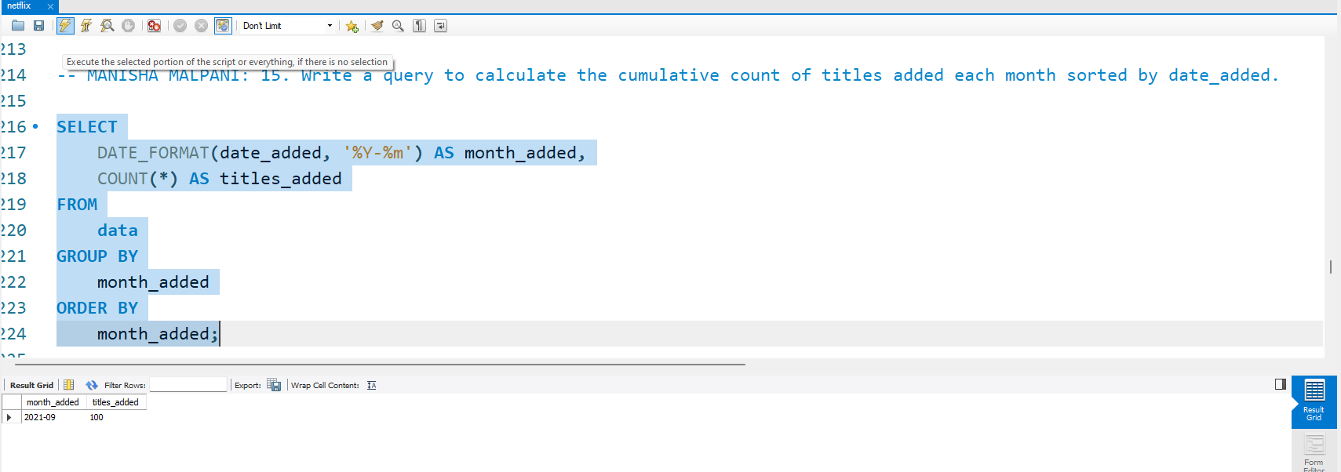
15. Write a query to calculate the cumulative count of titles added each month sorted by date_added.
Query –
SELECT DATE_FORMAT(date_added, '%Y-%m') AS month_added, COUNT(*) AS titles_added FROM data GROUP BY month_added ORDER BY month_added;

Slide 18
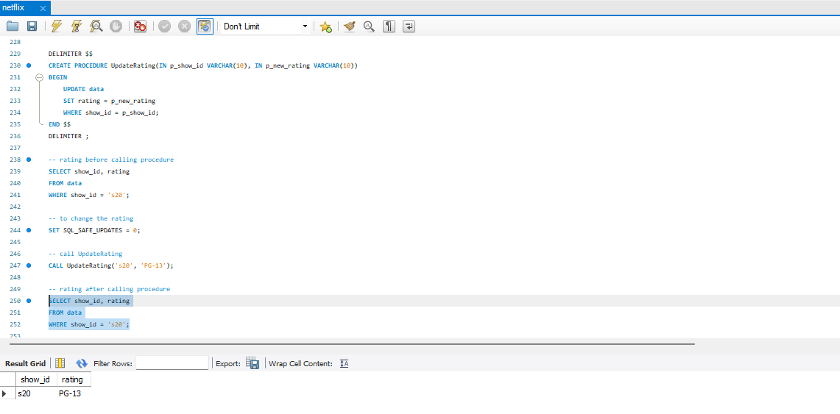
16. Write a stored procedure to update the rating of a title given its show_id and new rating.
Query –
DELIMITER $$ CREATE PROCEDURE UpdateRating(IN p_show_id VARCHAR(10), IN p_new_rating VARCHAR(10)) BEGIN UPDATE data SET rating = p_new_rating WHERE show_id = p_show_id; END $$ DELIMITER ;
CALL UpdateRating('s20', 'PG-13');

Slide 19
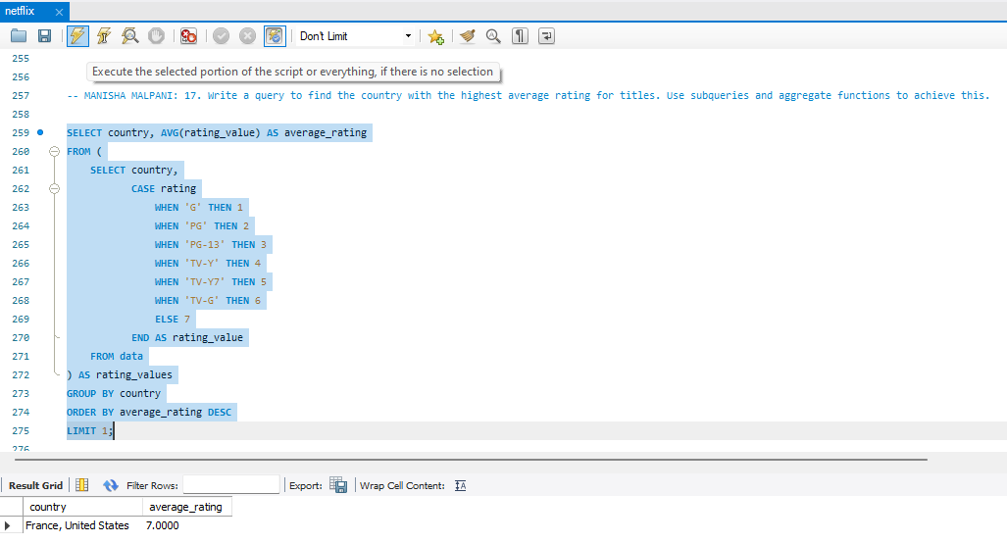
17. Write a query to find the country with the highest average rating for titles. Use subqueries and aggregate functions to achieve this.
Query –
SELECT country, AVG(rating_value) AS average_rating FROM (SELECT country, CASE rating WHEN 'G' THEN 1 WHEN 'PG' THEN 2 WHEN 'PG-13' THEN 3 WHEN 'TV-Y' THEN 4 WHEN 'TV-Y7' THEN 5 WHEN 'TV-G' THEN 6 ELSE 7 END AS rating_value FROM data) AS rating_values GROUP BY country ORDER BY average_rating DESC LIMIT 1;

Slide 20
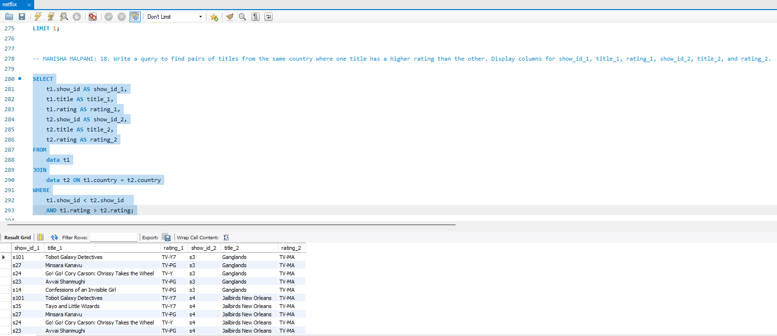
18. Write a query to find pairs of titles from the same country where one title has a higher rating than the other. Display columns for show_id_1, title_1, rating_1, show_id_2, title_2, and rating_2.
Query –
SELECT t1.show_id AS show_id_1, t1.title AS title_1, t1.rating AS rating_1, t2.show_id AS show_id_2, t2.title AS title_2, t2.rating AS rating_2 FROM data t1 JOIN data t2 ON t1.country = t2.country WHERE t1.show_id < t2.show_id AND t1.rating > t2.rating;

Slide 21

THANK YOU

